Slide 1


Public Education and Outreach Campaign
FY 2020-2021 Media Plan
Presented August 4, 2020

Slide 2
Program Overview
Campaign Goal
Campaign Objective
New Website Preview
Measuring Campaign Success
Success Measurements To Date
Post-campaign Evaluation Study 2021
FY 20-21 Creative Plan
FY 20-21 Media Plan

Slide 3
Campaign Goal
The goal, as agreed to with First 5 California, of the Public Education and Outreach Campaign is to change the behavior of parents and caregivers of children ages 0-5 across California to talk, read, and sing with their children from day one.
This goal is based on the decision by First 5 California and the state commission about the need for parents and caregivers across California to understand the critical role they play in their child’s early brain development and the ways in which they can help set the foundation for their child’s future success.
All efforts developed and run through the campaign are designed to meet this goal of sustained behavior change.

Slide 4
Campaign Objectives and Measurement
Increase website visits and engagements
  Measured by visits
Increase social media engagement
  Measured by visits and clicks

Slide 5
New Website
Phase 1 of the website launch is a soft launch (currently scheduled for August 10), includes all English content with rich resources for parents and caregivers
  A preview of the website via the staging site can be viewed here: https://f5ca.netlify.app/en-us/
Phase 2 of the website launch, which will include the Spanish website and age-specific personalization, is set to launch mid- to late-September
The planned goals for visits to the new website are:
  100,000 or more unique monthly visits*
    A 111% increase from monthly average unique visits for FY 19-20 (was 47,224)
  Average 3 pages per session*
    A 71% increase from average page visits per session for FY 19-20 (was 1.76)
  Average 15% return visitors per month*
    A 38% increase from average return visits for FY 19-20 (was 10.9%)
*These are goals based on the current budget and media plan as presented

Slide 6
Measuring Campaign Success
As a means to measure behavior change, Fraser relies on the use of a third-party quantitative research study to measure and evaluate campaign success and if the behavior change goal has been achieved.

Slide 7
Success Measurements To Date
Since 2015 there have been four third-party research evaluations conducted that report on the campaign outcomes:
  NORC at the University of Chicago (2015)
  IPSOS (2016)
  IPSOS (2018)
  CHIS (2019)
The most recent study by CHIS in 2019 found the following research study success:
  Most parents are reading and singing to their young children
  88% reading three times or more per week
  91% singing three times or more per week
  Recognition of the message of the Talk. Read. Sing.® campaign is high (87%)
  Parents who have seen the message are:
    Nearly 3 times more likely to read to their child three days or more per week
    Twice as likely to sing to their child three days or more per week
Where the CHIS 2019 report found areas for improvement, included:
  Parents who are foreign-born or who speak Spanish at home are less likely to read or sing to their young children than both their U.S.-born counterparts and those who do not speak Spanish at home. Specifically:
    Parents who speak Spanish at home or speak both English and Spanish at home are less likely to read to their children compared to parents who speak only English, even when adjusting for education
    Foreign-born parents are less likely to sing to their children, even when adjusting for education and race-ethnicity

Slide 8
Post-campaign Evaluation Study
April 2021
The current plan for the post-campaign research study is for it to be conducted in April 2021 with an evaluation and executive report to be provided in May 2021
This date and plan for conducting the research is flexible, if the desire is to expedite the evaluation

Slide 9
Creative Plan
The upcoming year’s media plan will include a combined use of new and existing creative assets
  Media planned to have a sustained presence to reach parents at key times throughout year
  TV and radio will run a mix of produced spots targeted to low-income and hard-to-reach audiences
  Digital and social media creative will be updated monthly to drive traffic to different areas of the website
  Custom creative executions are planned with our in-language media partners Univision, Estrella, Crossings TV, Radio Bilingüe, and La Campesina
New Website Promotion
  Added social media content highlighting website content and activities
  Digital banners announcing new website and driving web traffic
  :15s & :10s radio tip messages airing during traffic, news, and weather reports
  Custom executions with BabyCenter.com and Univision radio and social media driving visitors/viewers to the new site
  Press release and earned media pitching
    Working with the office of the Surgeon General to help with the announcement of the new site; either with a Zoom press conference and/or a quote in the release
New Creative
  New TV spot was developed giving thanks to parents and caregivers who are raising California’s future
    Planned to start airing Monday, August 17

Slide 10

“ODE to Parents – Tomorrow”

Slide 11
Media Planning
Strategies
FY 20-21 MEDIA STRATEGIES
Surround our audience throughout their day with Talk. Read. Sing. messaging
Stagger traditional Network TV and cable weeks for an ongoing TV presence
Stagger TV and radio weeks for an ongoing weekly on-air presence
Run digital efforts on an ongoing basis to drive clicks to the website
Optimize buys (traditional and digital) to ensure reach of low-income and hard-to-reach parents and caregivers of children 0-5
  Special effort for HHI >$25K, African American, Latinx, moms, dads
  In-language Spanish, Asian languages (Mandarin, Cantonese, Hmong, Vietnamese, Korean, and Tagalog), and Russian
Continue to use Trusted Sources as First 5 California Ambassadors

Slide 12
Media Plan Key Performance Indicator (KPI)
The KPI across all media campaign creative will be to drive traffic to the First 5 California website
In addition to the website goals, Fraser will continually look at third-party data to track campaign results, optimize, and evaluate success
  Where available, industry benchmarks will be used to compare success rates and needs for optimization and/or adjustments
  Reporting of all media executions is compiled in comprehensive Quarterly Reports submitted by Fraser

Slide 13
TV Approach
We recommend continuing traditional network TV and cable to ensure delivery in key dayparts such as primetime, layered with programmatically purchased TV (purchased digitally) to increase our targeting capabilities
Increase presence on streaming TV platforms that allow ads (Hulu and Sling)

Slide 14
Digital Approach and Enhancements
Increase digital/social media based on parent and caregiver usage increases
Increase pre-roll video and streaming audio
Expand presence on social media platforms using paid ads and influencers
Increase rotation of Native Ads to align with congruous information and display more of our website specific content

Slide 15
Social Media
Approach
Continue to develop timely, helpful, and eye-catching content for organic posting on Facebook, Instagram, and Pinterest
  Continue content related to COVID-19, Census (through October), Talk. Read. Sing., and a wide variety of health, learning, activity, and resource topics from the new website
Boost content across Facebook and Instagram to ensure reach and engagement
Continue to build on Facebook Live success with additional opportunities to bring parents and caregivers at-home content and entertainment
Work with Influencers to provide content that positions First 5 California as their 'go-to' resource for info, advice, tips, activities, etc.
Continue utilizing social influencers to share Talk. Read. Sing. messaging, gain social followers for First 5 California pages, and lead people to the website

Slide 16
FY 20-21 Media Flow Chart

Slide 17
Thank You!

Slide 18
Appendix

Slide 19
FY 20-21 Media Planning Approach
In order to reach maximum awareness and move the needle of public awareness and behavior change, a comprehensive multi-media approach has been developed and executed to meet all target audiences throughout California.
The media funnel below diagrams how our approach covers every stage necessary for behavior change to occur – from awareness, to interest, to intent, to conversion – and how each media chosen helps accomplish the ultimate goal of action and sustained behavior. The funnel also helps show that no matter where parents and caregivers access their information at any point in their behavior change journey, First 5 California’s messages are available to them and customized in ways that are most digestible, actionable, and appropriate for its medium.
AWARENESS
Broad Awareness Media
(TV, Radio)
Digital Display/Video/Audio
(Direct Site & Prospecting)
INTEREST
Social Media
Native Content/
Outreach
INTENT
Paid Search
& Retargeting
Webpage
CONVERT
Action & Sustained Behavior

Slide 20
Impact of COVID-19 on Media Trends
MARCH SNAPSHOT
Households tuning into television were at Superbowl Sunday levels in some weeks.
The 4 major cable news networks saw a 90% increase in viewership.
Video on demand increased 15-20% day over day in peak weeks.
Local TV Stations saw double, even triple their normal ratings.
Radio listening remained stable despite less in-car listening.
The local radio news networks saw peak listening.
Sources: Nielsen, Scarborough, Canoe Data.

Slide 21
Impact of Upcoming General Election
The November 3rd Election will drive higher rates, advertising clutter, and pre-emptions due to political ads
Fraser recommend minimizing First 5 California’s TV presence during the 6 weeks leading up to the election
To compensate, Fraser will ramp up in cable, digital, and radio activity
  Exclude news from cable during this time to avoid adjacency to polarizing content

Slide 22















TV and Streaming TV
LINES CONTINUE TO BLUR
Platforms to purchase traditional TV programmatically continue to evolve
Different capabilities allow for dovetailing programmatic targeting technology to maximize reach of our audience across Spot TV and Cable
OTT/CTV will be available to include with some Spot TV vendors in FY 20-21
  OTT = Over the top Inventory
  CTV = Connected TV
  Used interchangeably in reference to digital TV inventory on platforms like Hulu, Sling and other viewing apps
Number of streaming services/platforms is increasing, however not all of these have advertising available on their platforms
PAID SUBSCRIPTION
(Ad-Free)
PAID SUBSCRIPTION
(Limited Ads)
FREE – AD SUPPORTED

Slide 23
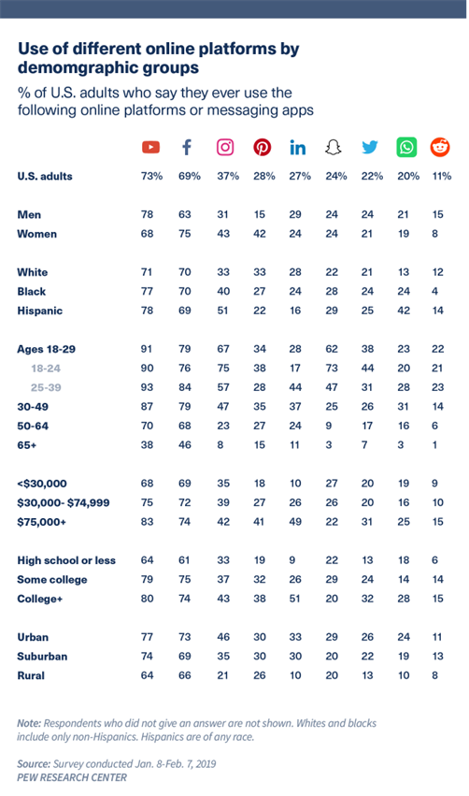
Social Media Trends
Survey conducted by PEW Research Center in Jan-Feb 2019 shows the use of social media platform by demographic groups
  Survey did not include TikTok as it was in its infancy at the time

Slide 24
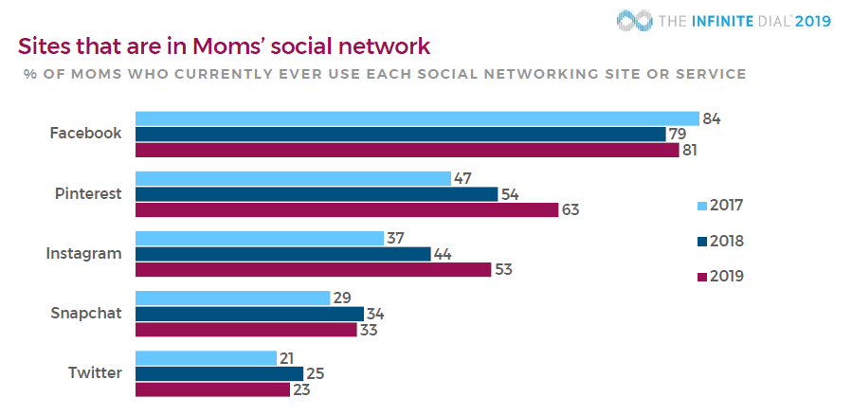
Social Media Trends - Moms
58% of parents browse social media after their kids have gone to sleep (eMarketer, 2018)
Facebook remains the #1 used social platform by Moms, but Pinterest and Instagram use increase significantly from 2018-2019
Snapchat is used by 1/3 of Moms and use stayed steady over the past years

Slide 25
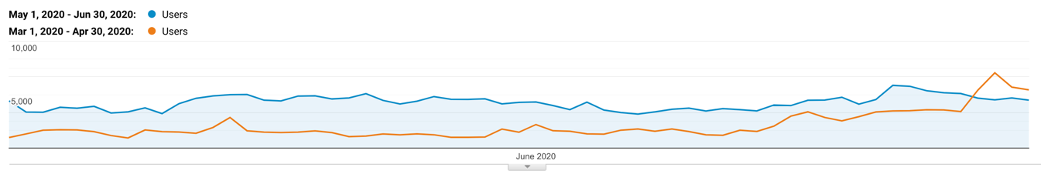
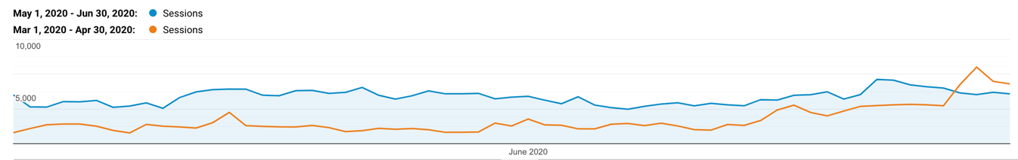
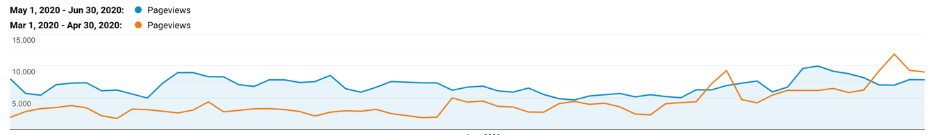
Website Traffic
May - June 2020
Analysis period: 5/1/20-6/30/20 vs. 3/1/20-4/30/20
There was an increase of 102% in unique users
  (237,604 vs. 117,185)
There was an increase of 98% in total website sessions
  (273,396 vs. 137,874)
There was an increase of 65% in pageviews
  (420,443 vs. 254,637)

Slide 26
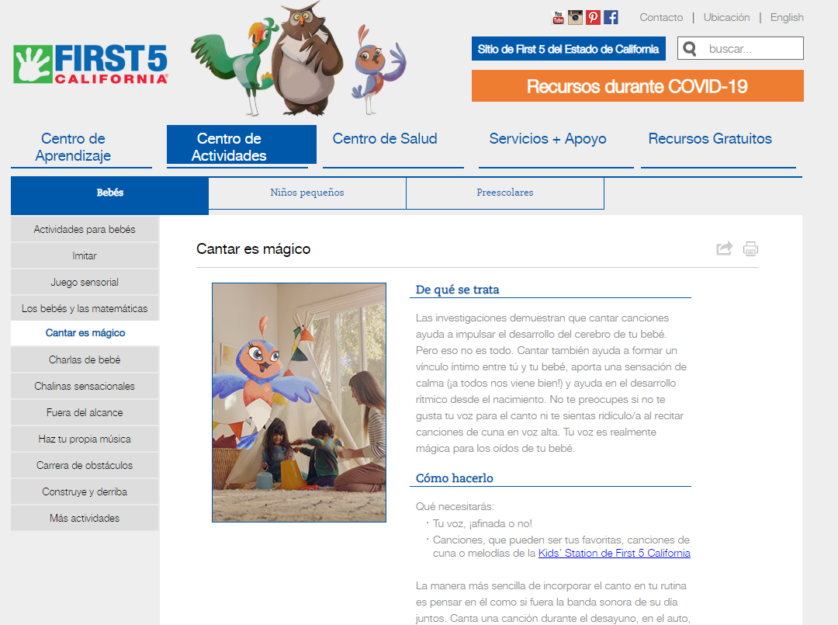
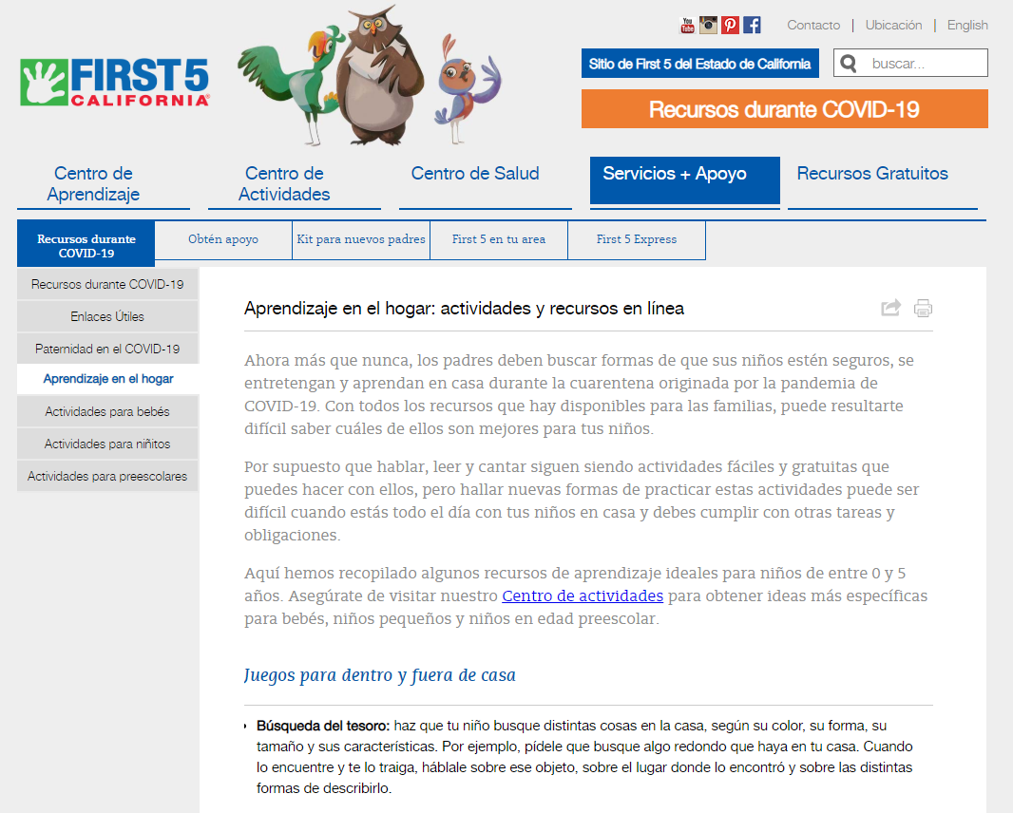
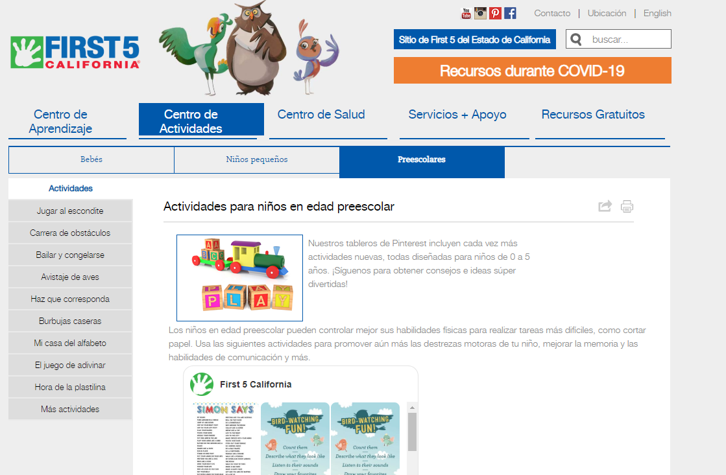
Website Traffic
May - June 2020
Analysis period: 5/1/20-6/30/20 vs. 3/1/20-4/30/20
Top 5 Pages:
  Home
  Español Home
  Spanish Activity Page
  Spanish COVID Resource Page
  Spanish Preschool Activity Landing Page

Slide 27
Social Media Snapshot:
May - June 2020
In response to and during the COVID-19 pandemic, overall social media activity on First 5 California’s channels have grown significantly, with meaningful increases noted across multiple areas including the Parent website
Website Traffic Correlated to Social Media
(Analysis period: 5/1/20-6/30/20 vs. 3/1/20-4/30/20)
There was an increase of 196% in website sessions that came from social media compared to the previous period (54,194 sessions vs. 17,676 sessions), with Facebook being the most significant traffic driver among our platforms
Website sessions via Facebook increased by 209% compared to the previous period.

Slide 28
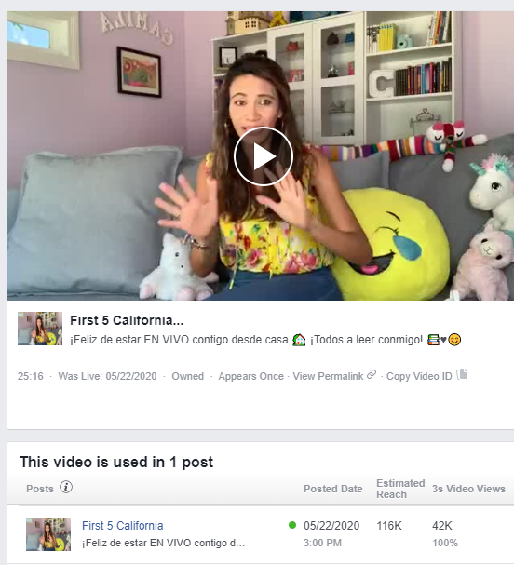
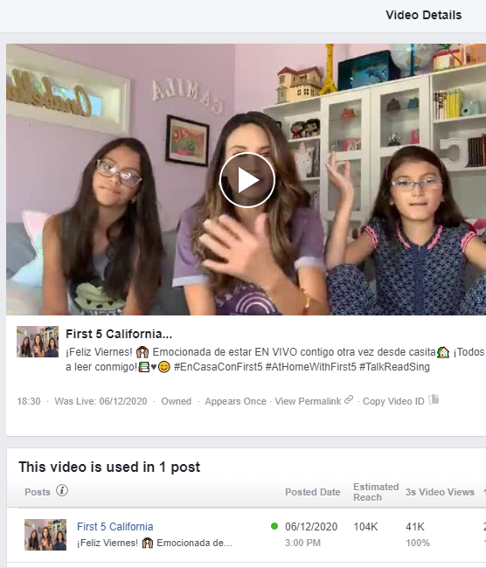
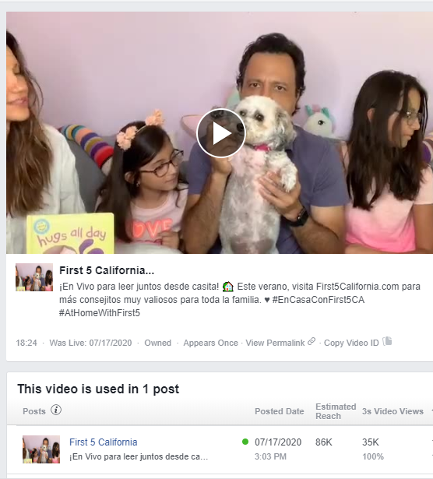
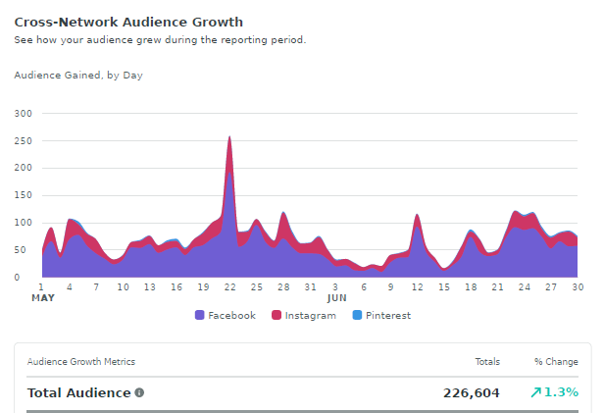
May-July Facebook Live Events
May 22 Bilingual Facebook Live with Argelia Atilano
116K people reached
42k video views
June 12 Bilingual Facebook Live with Argelia Atilano and family
104K people reached
41k video views
July 17 Bilingual Facebook Live with Omar, Argelia, and family
86K people reached
35k video views
Facebook and Instagram follower numbers both spiked on days featuring Facebook Live events:
May 22
June 12

Slide 29
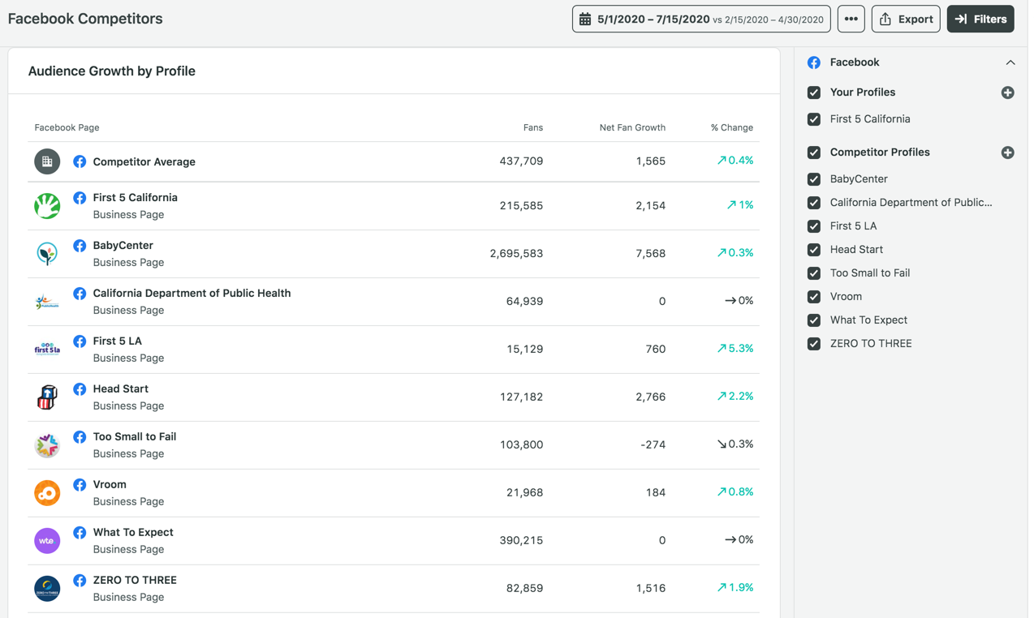
May-July Facebook Follower Growth
Follower growth has been up on Facebook during May-July. Below shows follower growth for First 5 California as compared to like-minded organizations during that same time period.

Slide 30
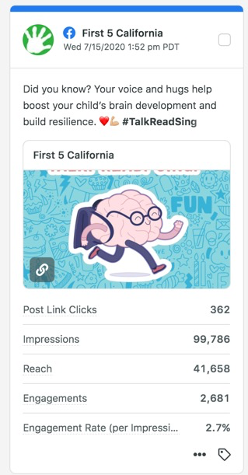
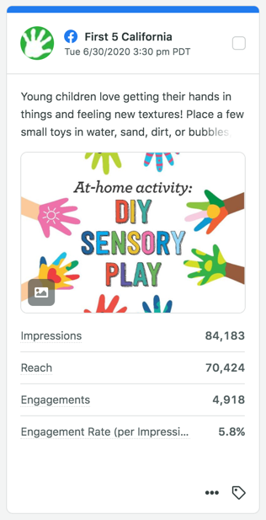
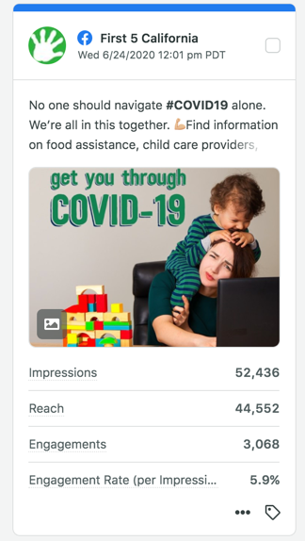
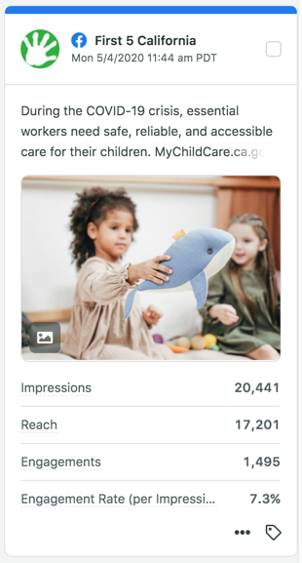
Social Media Snapshot:
May - July 2020
Timely, relevant and supportive posts that drove high engagement and clicks to the website

